Slide 1
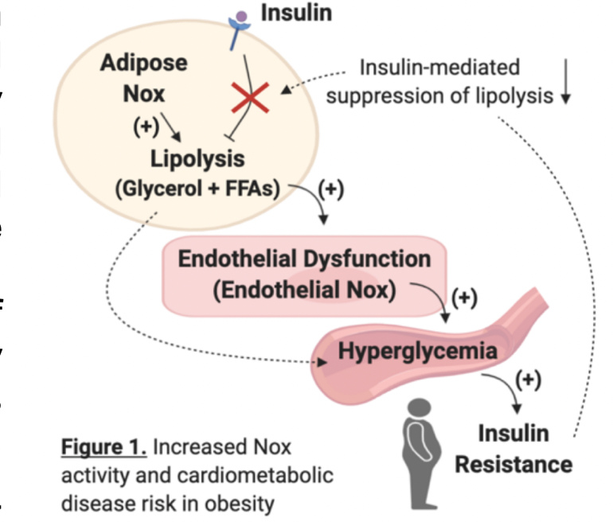
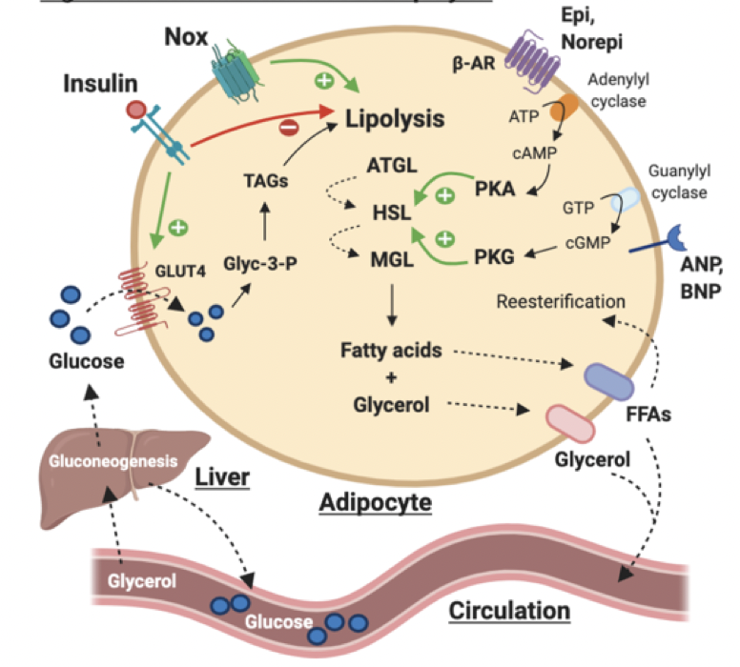
Literature Review – Vascular and Metabolic Dysfunction
Presenters: Ashley Holland, Isabella Eaton, Riley Hart, and Giovanna Cross
Research Mentors: Cesar Meza and Dr. Robert Hickner
Abstract
Introduction
Discussion
Vascular and metabolic dysfunction both occur in obesity, and increased NADPH oxidative (Nox) activity has emerged as a key event in the development of cardiometabolic diseases. Data from the Hickner laboratory has identified that Nox is a major determinant of vascular complications in people with obesity. There is, however, limited research in humans that integrates the effects of Nox in vascular and metabolic tissues. Cell culture studies have identified Nox as a stimulus of lipolysis, which is the process of breaking down stored triglycerides and releasing them into the bloodstream. The overall goal of this study is to understand if Nox in adipose tissue and the adipose vasculature contribute to elevated blood glucose profiles through heightened rates of lipolysis and subsequent increased gluconeogenesis and hepatic glucose output.
Cardiovascular disease (CVD) has posed a serious health concern in the United States, as one third of the population has been diagnosed with having obesity. Identifying CVD risk factors, such as insulin resistance, is essential to preventing the onset of overt CVD and type 2 diabetes. Oxidative stress plays an important role in the development of insulin resistance and endothelial dysfunction, which both occur early in the progression of cardiometabolic diseases (Cersosimo and DeFronzo, 2006). Since oxidative stress and insulin resistance both occur in CVD and type 2 diabetes, it is important to study how they are related. The Hickner laboratory has identified NADPH oxidase (Nox) as a major contributor to endothelial dysfunction in people with obesity (La Favor et al. 2016) and others have shown that Nox is involved in adipose tissue dysfunction. Nox stimulates lipolysis in adipocytes, but this might not occur through the primary (beta-adrenergic) signaling pathway (Krawczyk et al. 2012). Insulin exerts metabolic effects on adipose tissue by suppressing lipolysis after a meal. When an individual becomes insulin resistant, there are impairments in fatty acid metabolism that affect vascular function in addition to blood glucose control (Cersosimo and DeFronzo, 2006). As a result, people with insulin resistance often have high blood levels of lipids and glucose. In addition, vasodilation is improperly regulated when insulin sensitivity is reduced, resulting in an inability to activate nitric oxide synthase (NOS) in the endothelium, which is responsible for NO synthesis (Cersosimo and DeFronzo, 2006). The endothelium is essential in the regulation of blood flow, blood pressure, delivery of nutrients, and disposal of waste build up from metabolic processes (Cersosimo and DeFronzo, 2006). When these processes are impaired, the risk of developing cardiometabolic disease is increased (Cersosimo and DeFronzo, 2006).
We hypothesize that overproduction of Nox-derived ROS in people with obesity impairs blood glucose profiles by reducing insulin-mediated suppression of lipolysis.
Aim 1:
This is testing to see if Nox increases the breakdown of fat storage in the body (lipolysis).
The “interstitial glycerol” levels will be measured as a marker of lipolysis (see Lipolysis figure).
To see if Nox increases lipolysis through the predominant beta-adrenergic pathway, Nox will be inhibited (via apocynin) after stimulating this pathway via isoproterenol.
To see if Nox increases lipolysis through the secondary ANP pathway, Nox will be inhibited (via apocynin) after stimulating this pathway via ANP.
Aim 2:
This is testing to see if the increases in lipolysis caused by Nox affect the ability of insulin to suppress lipolysis.
Insulin will be infused intravenously at a constant rate during a hyperinsulinemic-euglycemic clamp.
The interstitial glucose levels will be measured to see how they are influenced by Nox and lipolysis.
We anticipate that overproduction of Nox-derived ROS in adipose tissue in people with obesity will cause an increase in lipolysis. Furthermore, Nox will have a greater effect on lipolysis and endothelial function through the ANP-mediated pathway than the isoproterenol (beta-adrenergic)-mediated pathway.
Research Questions
What is the mechanism by which Nox increases lipolysis?
Does the increase in Nox in adipose tissue contribute to insulin resistance and endothelial dysfunction in individuals with obesity? How does this compare to a person with a healthy body weight?
Methods
Study Schematic
Sample size = 30 men and women; 15 – normal weight, 15 – obese
Aim 1 (fasting conditions): Participants will undergo microdialysis procedures to determine the mechanism(s) by which Nox stimulates lipolysis in adipose tissue.
Apocynin (a Nox inhibitor) will be locally perfused into adipose tissue via microdialysis probes either with isoproterenol or atrial natriuretic peptide (ANP), which stimulate lipolysis via different signaling pathways.
Aim 2 (“fed” conditions): Following the microdialysis procedures from Aim 1, a hyperinsulinemic-euglycemic clamp will be initiated to mimic “fed” conditions and to determine the level of insulin resistance. Microdialysis procedures from Aim 1 will be repeated within Aim 2.
Clinical Implications
This research can play an important role in the mitigation of obesity and other vascular health diseases by pinpointing areas of focus for treatments, which can decrease the burden associated with treating obesity. Further, the implications of this area of research can be used to prevent the early progression of cardiovascular diseases as well as reduce later adverse events in patients.
Study Protocol
(Example Timeline for One Participant)
Lipolysis
Day 1 | Day 4 | Days 6 to 8 | Day 9 (Test Day)
Screened, enrolled and tested for blood levels of lipids and glucose | Body composition analysis (DXA scan) Brachial artery flow-mediated dilation, VO₂peak tests | 3-Day Food Log | Microdialysis, hyperinsulinemic- euglycemic clamp
References
Cersosimo and DeFronzo. (2006). Insulin resistance and endothelial dysfunction: The road map to cardiovascular diseases. Diabetes/Metabolism Research and Reviews, 22(6), 423–436.
Krawczyk et al. (2012). Reactive oxygen species facilitate translocation of hormone sensitive lipase to the lipid droplet during lipolysis in human differentiated adipocytes. PLoS One, 7(4), e34904.
La Favor et al. (2016). Microvascular endothelial dysfunction in sedentary, obese humans is mediated by NADPH Oxidase. Arteriosclerosis, Thrombosis, and Vascular Biology,36(12), 2412-2420.
Funding: National Institutes of Health-NHLBI (F31HL154642-01A1) PI: C. Meza.

